Slide 1
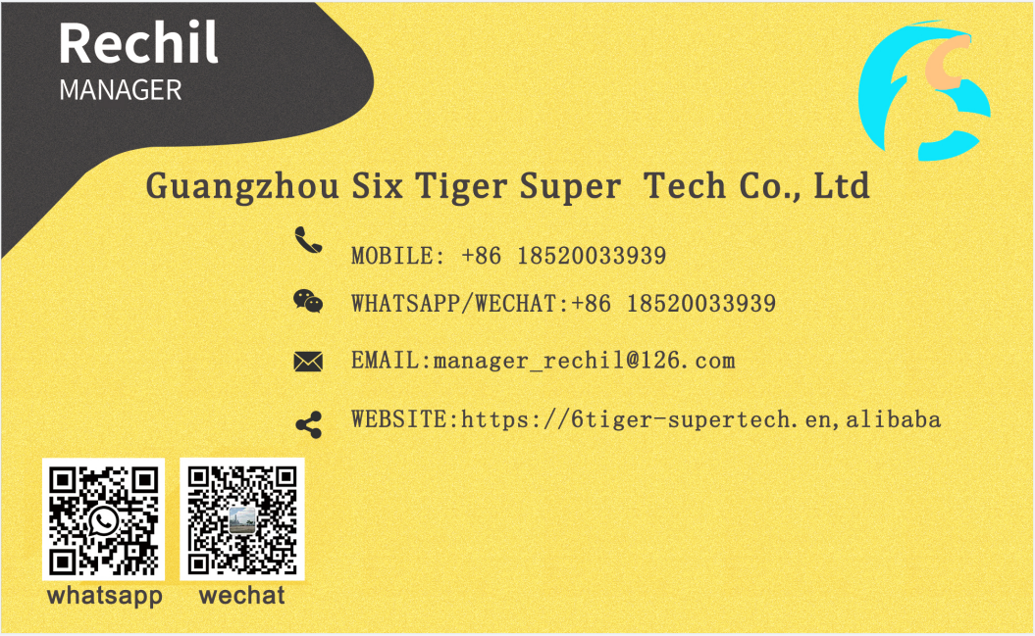
Guangzhou Six Tiger Super Technology Co.,Ltd
RO Water Purifier Production
OEM Manufacturer
EVERYONE DRINKS HEALTHY
WATER OEM /SOURCEFACTORY/ QUALITY ASSURANCE

Slide 2
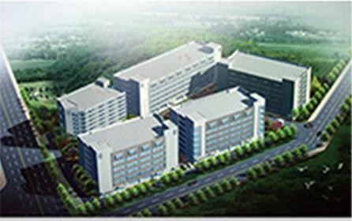
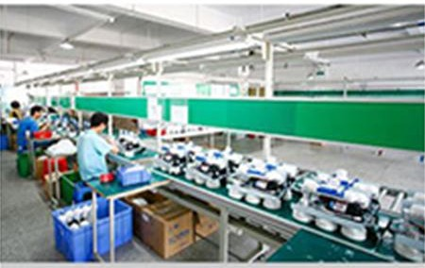
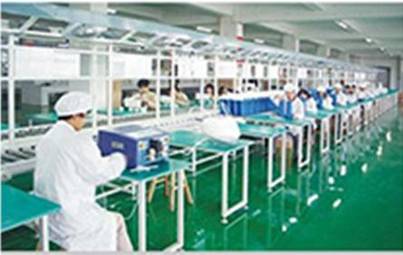
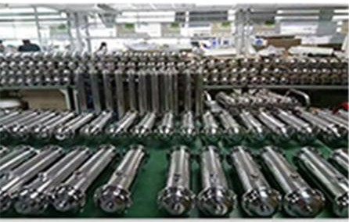
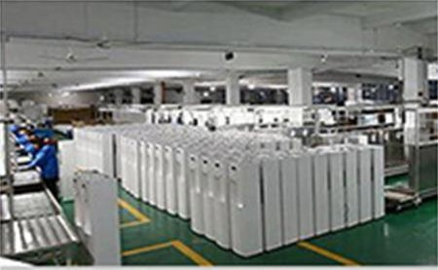
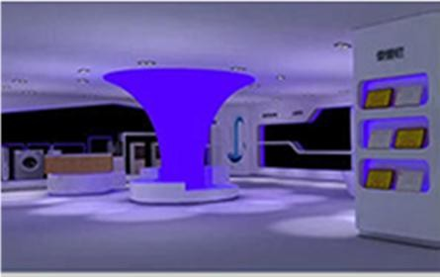
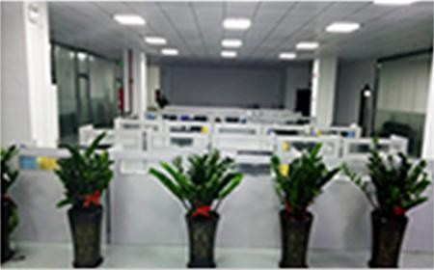
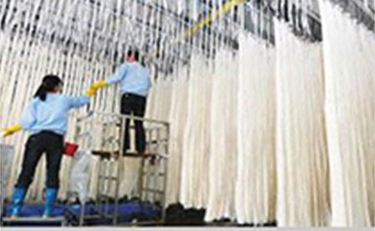
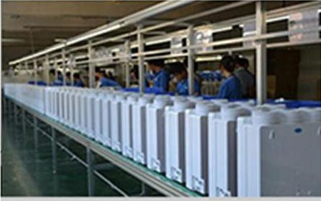

Slide 3
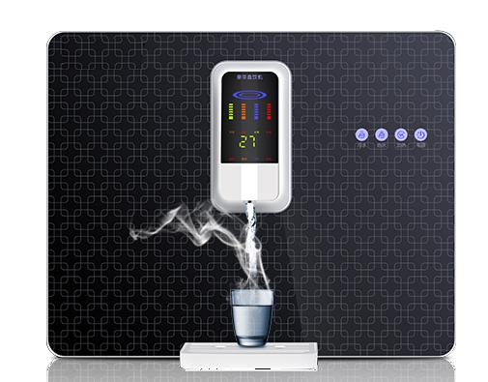
RO Water Purifier Series
Item No.：STW-ROD-3005 RO All-in-one
G.W：17.5KG Working Power：500W
Item Size：560*263*435 mm
Filter combination:5UPP+CTO+RO membrane+ Rear A tivated Carbon
Voltage：220V/50Hz
Accessories list : built-in 11L large water tank, Handway water pump, Juclear film juzhen solenoid valve, Juzhen high pressure switch and 1.5A power supply
RO纯水机系列

Slide 4
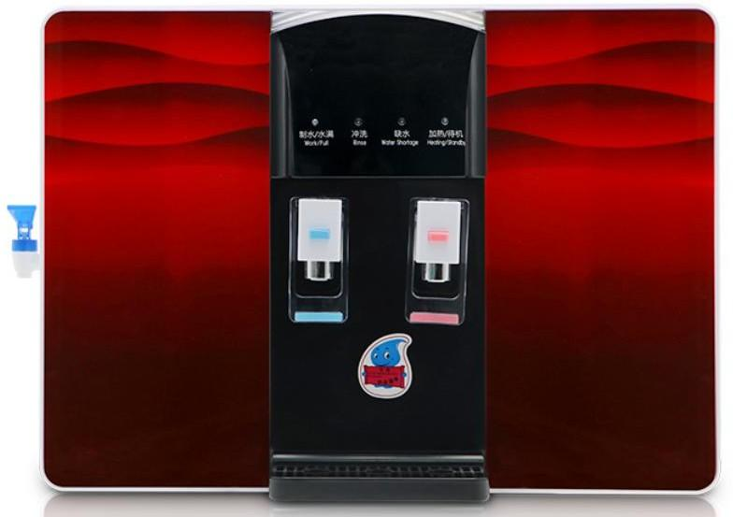
RO Water Purifier Series
Item No.：STW-ROD-3040
G.W：17.5KG
Item Size：560*221*460 mm
Heating Power：500W
Voltage：220V/50Hz
Working Power：500W
Function： 4 Level 25°C（direct drink） Child Knock
Accessories list : built-in 11L large water tank, Handway water pump, Juclear film juzhen solenoid valve, Juzhen high pressure switch and 1.5A power supply
RO纯水机系列

Slide 5
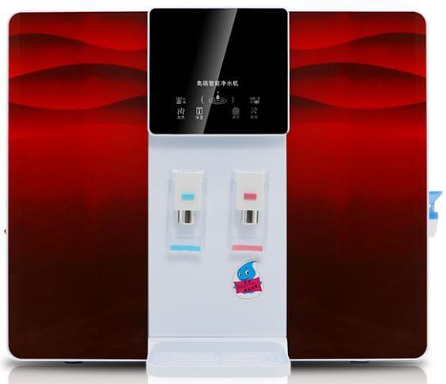
RO Water Purifier Series
Item No.：STW-ROD3080
LCD display cold and hot all-in-one machine
G.W：17.5KG
Item Size：560*221*460 mm
Heating Power：500W
Voltage：220V/50Hz
Working Power：500W
Function： 4 Level 25°C（direct drink） Child Knock
Accessories list : built-in 11L large water tank, Handway water pump, Juclear film juzhen solenoid valve, Juzhen high pressure switch and 1.5A power supply
RO纯水机系列

Slide 6
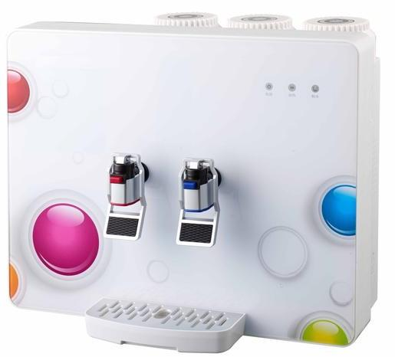
RO Water Purifier Series
Item No.：STW-ROD2030
Item Size：490*189.5*398mm
Voltage：220V/50Hz
Working Power：500W
Function： 4 Level 25°C（direct drink） Child Knock
Accessories list : built-in 5L large water tank built-in 5L large water tank 75G self-priming water pump 75G membrane real true solenoid valve real true high voltage switch 1.5A power supply
RO纯水机系列

Slide 7
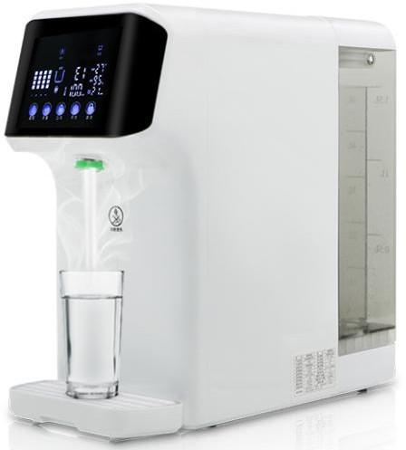
RO Water Purifier Series
Item No.：STW-ROD2095
Item Size：244*465*465MM
Voltage：220V/50Hz
Working Power：2000W
Function： 4 Level 25°C（direct drink） Child Knock
Accessories list :75 delta self-priming pump 75 confluence membrane rare earth heating plate 4 filtration(PP+CTO+PP)+RO+ carbon fiber) 8L large tank (pure water1.5 litres raw water 6.5 litres)
RO纯水机系列

Slide 8
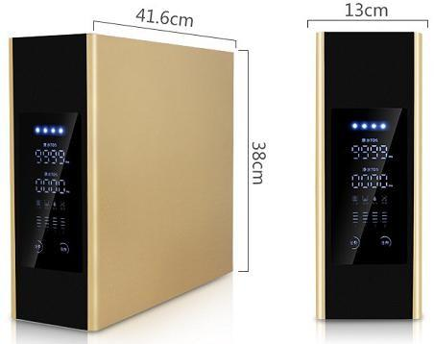
RO Water Purifier Series
Item No.: STW-ROD2095
G.W: 13 KG
Product Size：130*416*380mm
Filter flow: 75 GDP
Accessories list : Ultra-thin design, with raw water TDS display, pure water TDS value display, with filter core replacement reminder function touch computer board, 75G self-priming water pump 75GRO film 3.2g plastic pressure barrel real real solenoid valve real real high/low pressure switch 1.5A power supply
RO纯水机系列

Slide 9
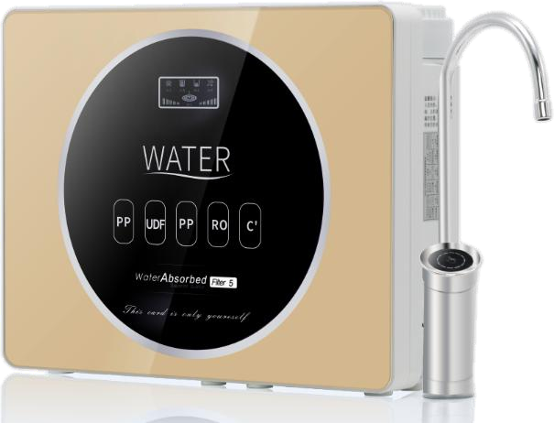
RO Water Purifier Series
Item No.: STW-ROD3005-1
G.W: 13 KG
Product Size：485*150*385mm
Filter flow: 75 GDP
Accessories list : Ultra-thin design, with raw water TDS display, pure water TDS value display, with filter core replacement reminder function touch computer board, 75G self-priming water pump 75GRO film 3.2g plastic pressure barrel real real solenoid valve real real high/low pressure switch 1.5A power supply
RO纯水机系列

Slide 10
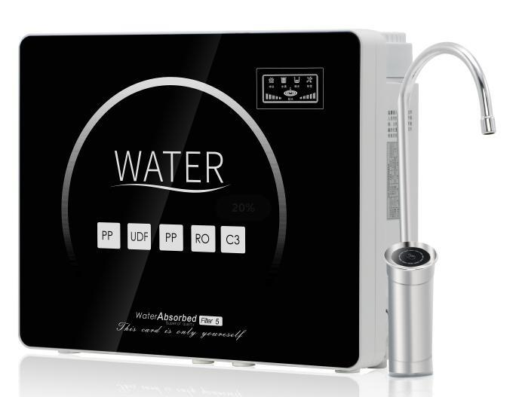
RO Water Purifier Series
RO纯水机系列
Item NO.: STW-ROD-2036
G/W：13KG
Poroduct Size: 387*137*397mm
Filter element combination: 5UPP cotton + granular carbon +1UPP cotton +RO membrane + coconut shell T33
FIlter Flow：75GPD
Accessories list: Ultra-thin design, with raw water TDS display, pure water TDS value display, with filter core replacement reminder function touch computer board, 75G self-priming water pump 75GRO film 3.2g plastic pressure barrel real real solenoid valve real real high/low pressure switch 1.5A power supply

Slide 11
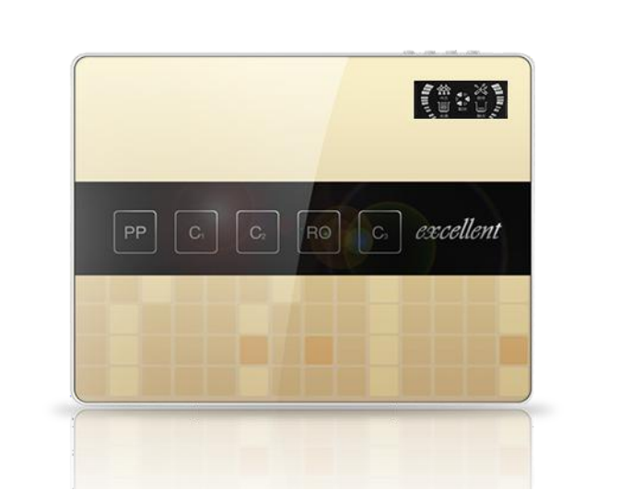
RO Water Purifier Series
Item NO.: STW-ROD-2039
G/W：12KG
Poroduct Size: 387*137*397mm
Filter element combination: 5UPP cotton + granular carbon +1UPP cotton +RO membrane + coconut shell T33
FIlter Flow：75GPD
Accessories list: Luxury three-fork big bend faucet 3.2g explosion-proof pressure barrel 75G self-priming pump 75GRO membrane true true solenoid valve true true high voltage switch 1.5A power supply.
RO纯水机系列

Slide 12
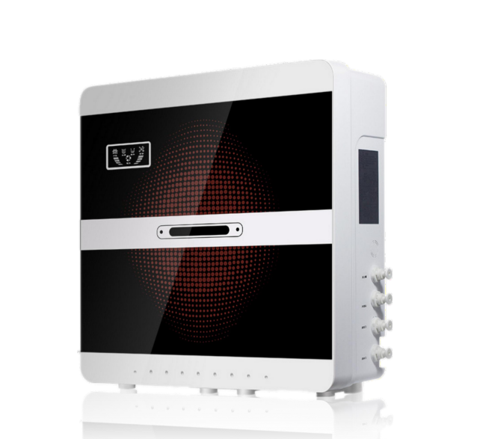
RO Water Purifier Series
RO纯水机系列
Item NO.: STW-ROD-2086
G/W：12KG
Poroduct Size: 387*137*397mm
Filter element combination: 5UPP cotton + granular carbon +1UPP cotton +RO membrane + coconut shell T33
FIlter Flow：75GPD
Accessories list: Luxury three-fork big bend faucet 3.2g explosion-proof pressure barrel 75G self-priming pump 75GRO membrane true true solenoid valve true true high voltage switch 1.5A power supply.

Slide 13
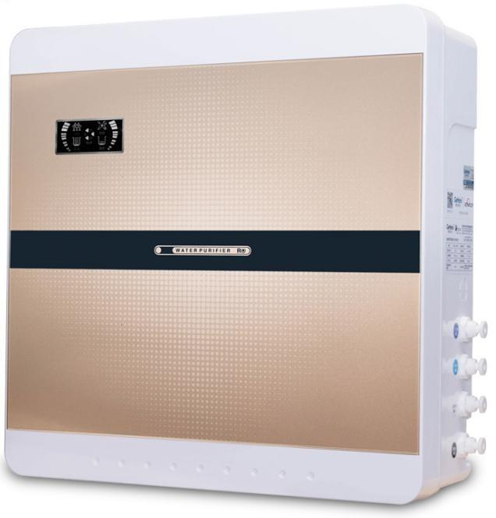
RO Water Purifier Series
RO纯水机系列
Item NO.: STW-ROD-2087
G/W：12KG
Poroduct Size: 387*137*397mm
FIlter Flow：75GPD
Accessories list: Luxury three-fork big bend faucet 3.2g explosion-proof pressure barrel 75G self-priming pump 75GRO membrane true true solenoid valve true true high voltage switch 1.5A power supply.

Slide 14
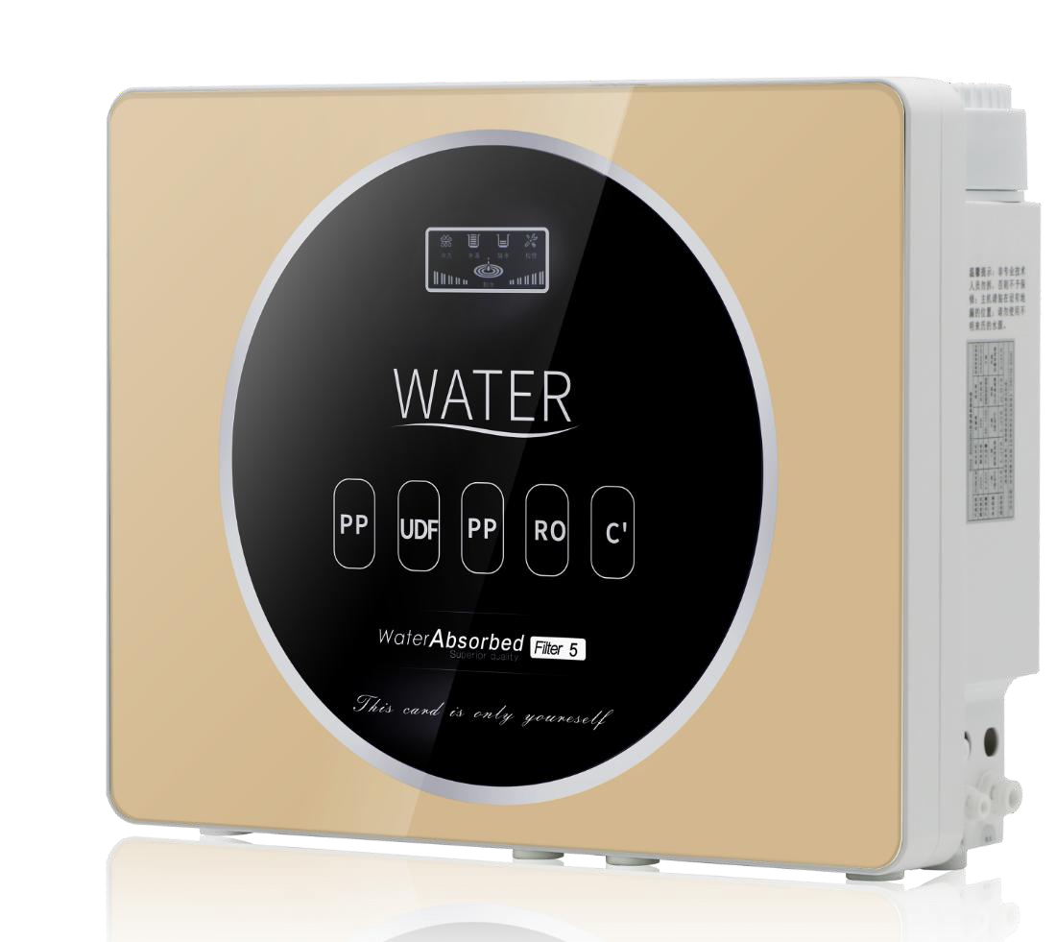
RO Water Purifier Series
RO纯水机系列
Item NO.: STW-ROD-3005
G/W：13KG
Poroduct Size: 485*150*385mm
FIlter Flow：75GPD
Accessories list: Luxury three-fork big bend faucet 3.2g explosion-proof pressure barrel 75G self-priming pump 75GRO membrane true true solenoid valve true true high voltage switch 1.5A power supply.

Slide 15
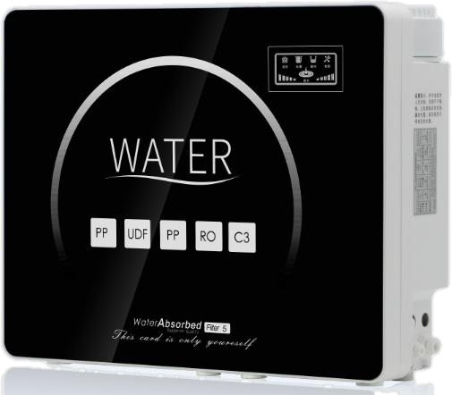
RO Water Purifier Series
Item NO.: STW-ROD-3006
G/W：13KG
Poroduct Size: 485*150*385mm
FIlter Flow：75GPD
Accessories list: Luxury three-fork big bend faucet 3.2g explosion-proof pressure barrel 75G self-priming pump 75GRO membrane true true solenoid valve true true high voltage switch 1.5A power supply.

Slide 16
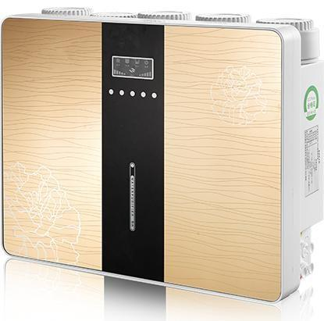
RO Water Purifier Series
RO纯水机系列
Item NO.: STW-ROD-1116
G/W：13KG
Poroduct Size: 485*150*385mm
FIlter Flow：75GPD
Accessories list: Luxury three-fork big bend faucet 3.2g explosion-proof pressure barrel 75G self-priming pump 75GRO membrane true true solenoid valve true true high voltage switch 1.5A power supply.

Slide 17
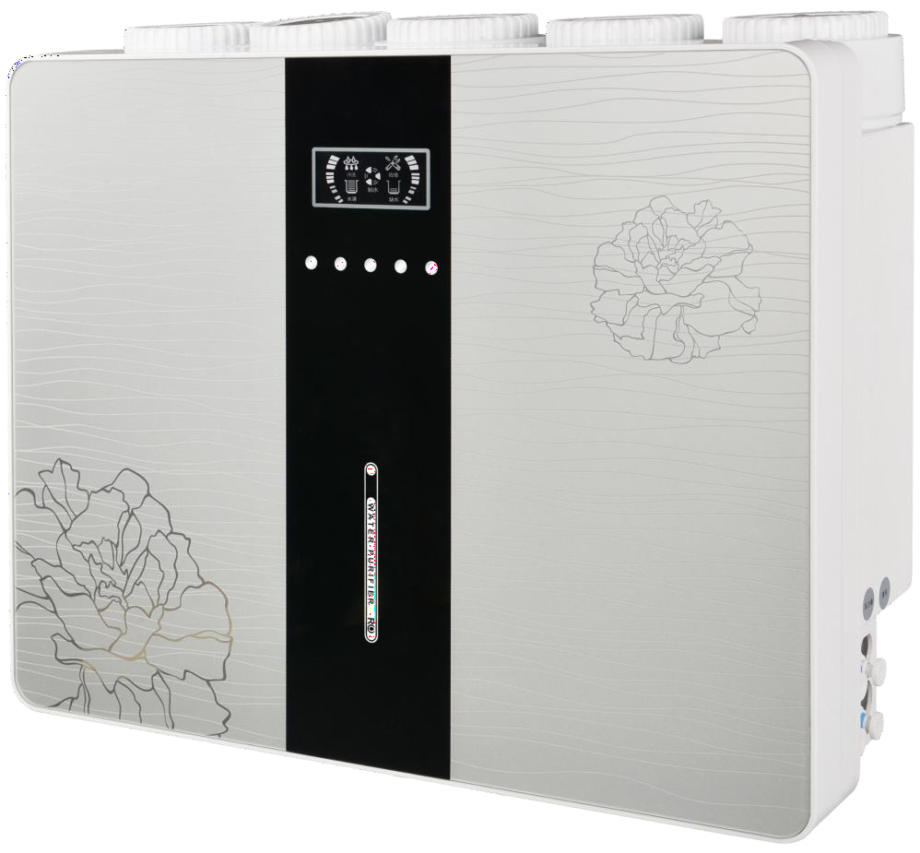
RO Water Purifier Series
RO纯水机系列
Item NO.: STW-ROD-1117
G/W：13KG
Poroduct Size: 485*150*385mm
FIlter Flow：75GPD
Accessories list: Luxury three-fork big bend faucet 3.2g explosion-proof pressure barrel 75G self-priming pump 75GRO membrane true true solenoid valve true true high voltage switch 1.5A power supply.

Slide 18
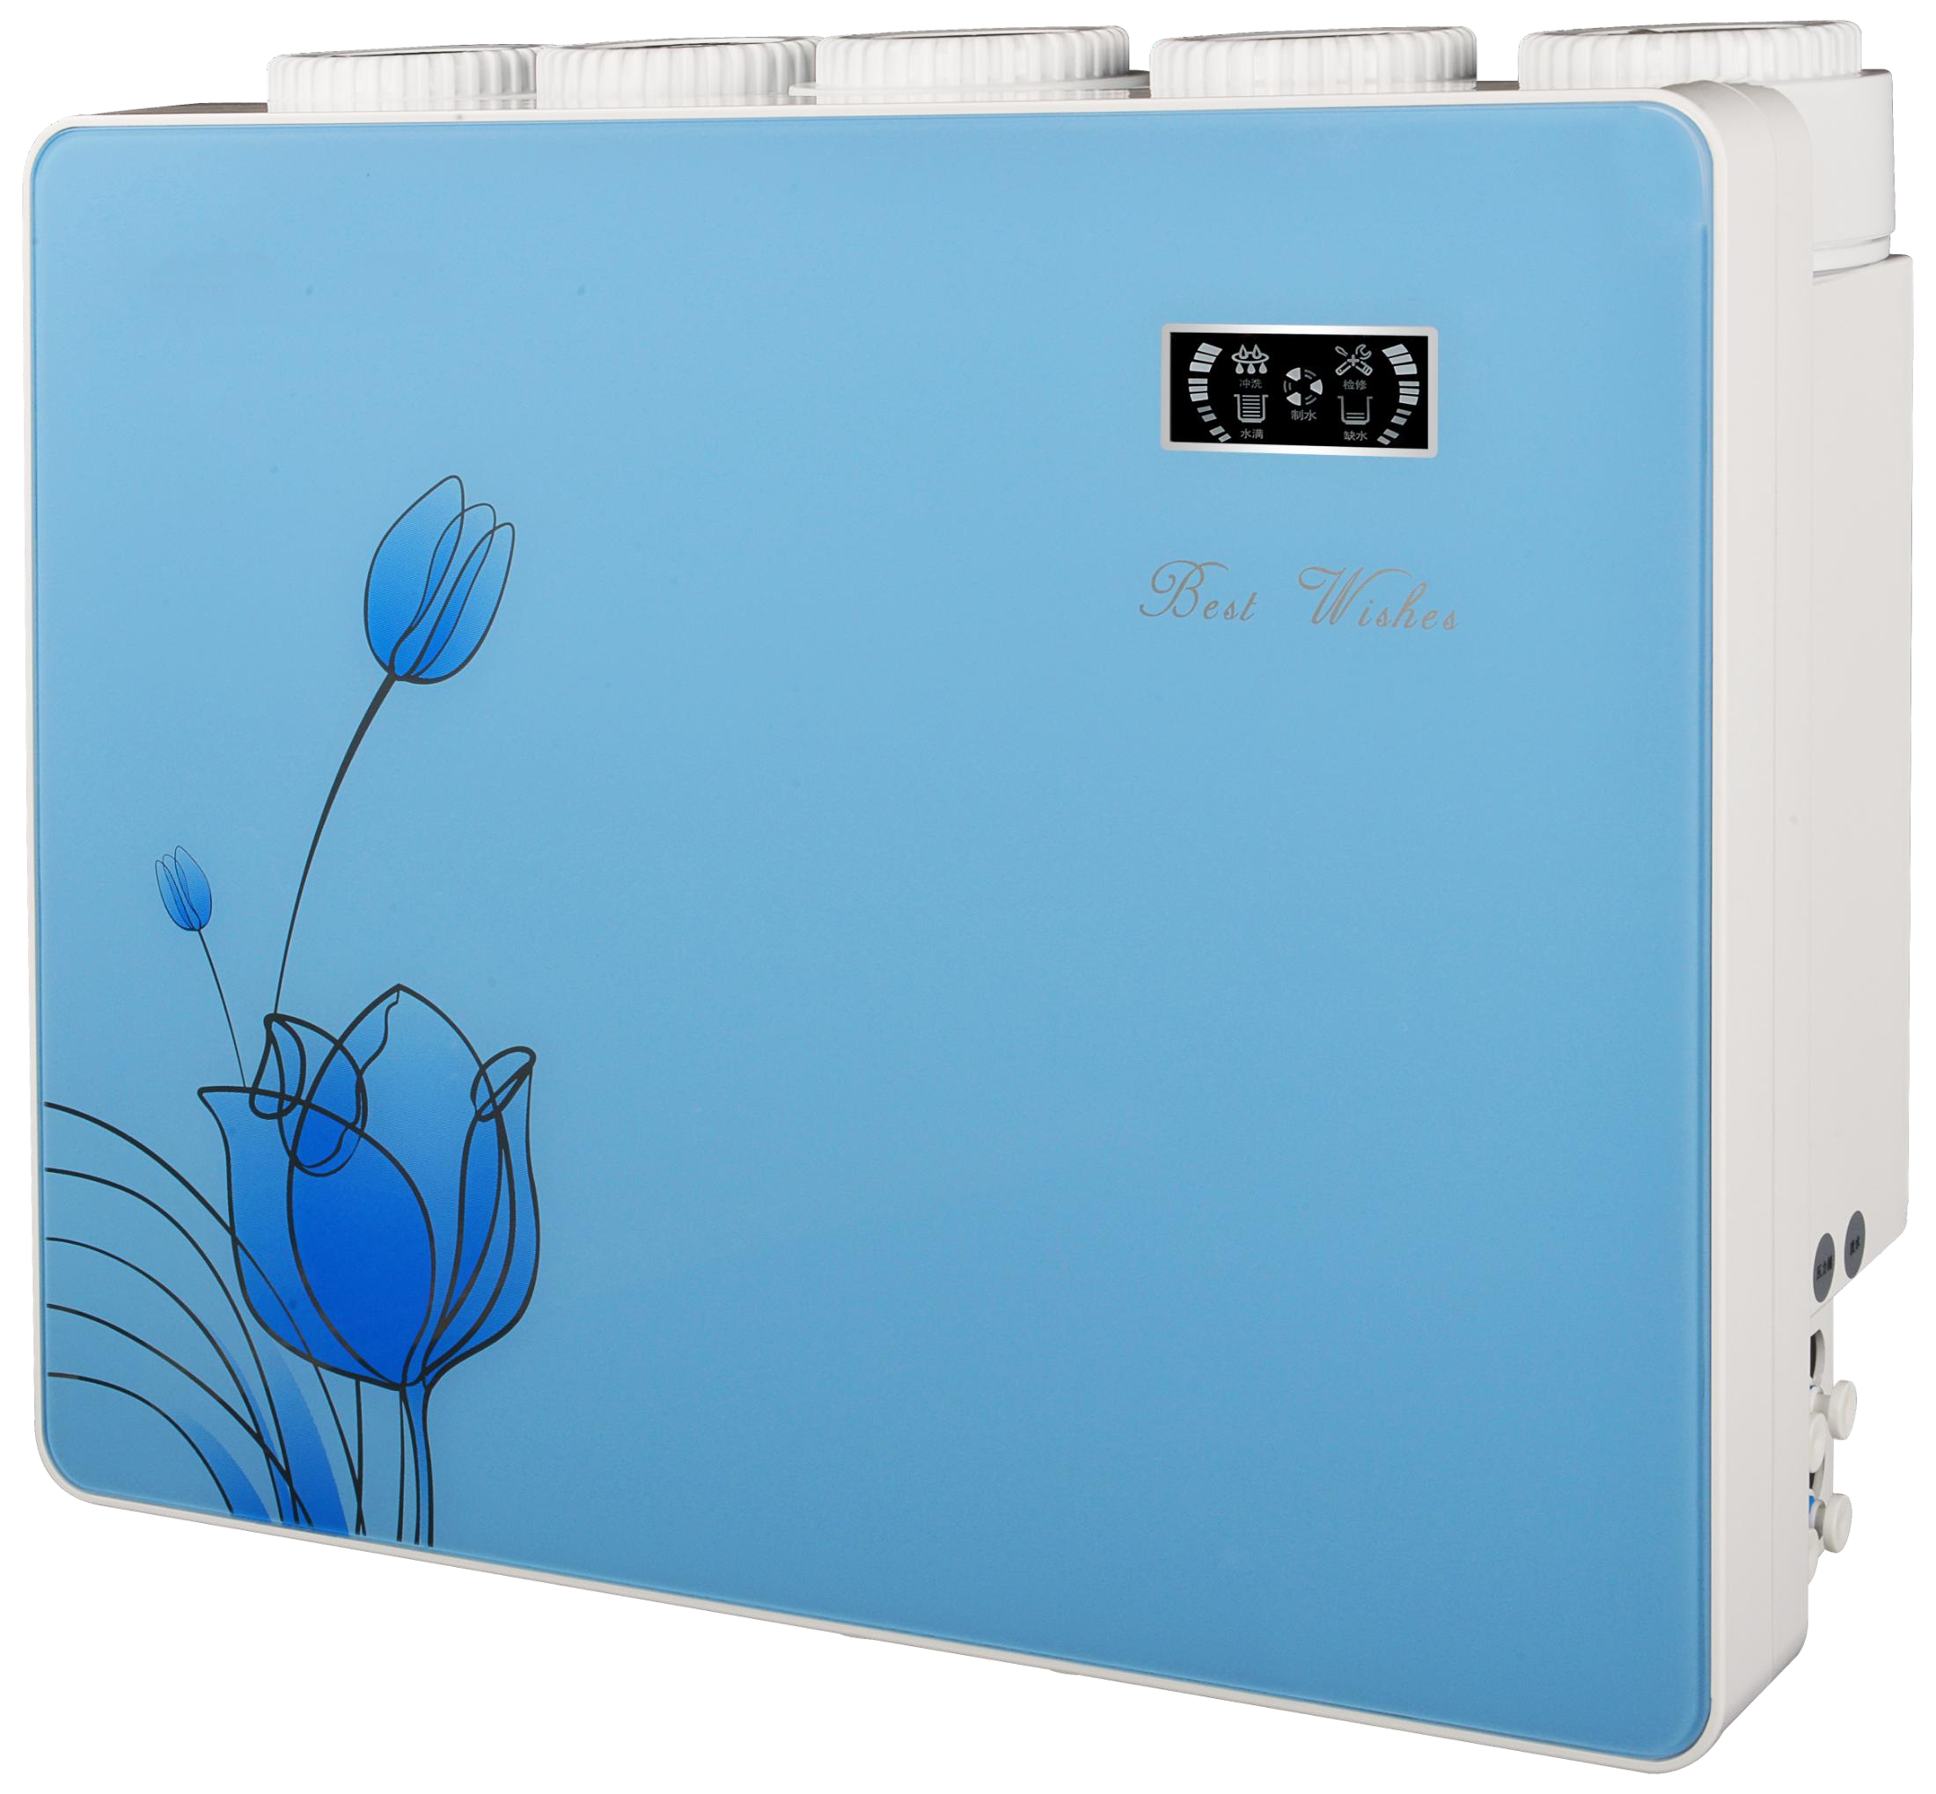
RO Water Purifier Series
Item NO.: STW-ROD-1118 Clamp
G/W：13KG
Poroduct Size: 485*150*385mm
FIlter Flow：75GPD
Accessories list: Luxury three-fork big bend faucet 3.2g explosion-proof pressure barrel 75G self-priming pump 75GRO membrane true true solenoid valve true true high voltage switch 1.5A power supply.

Slide 19
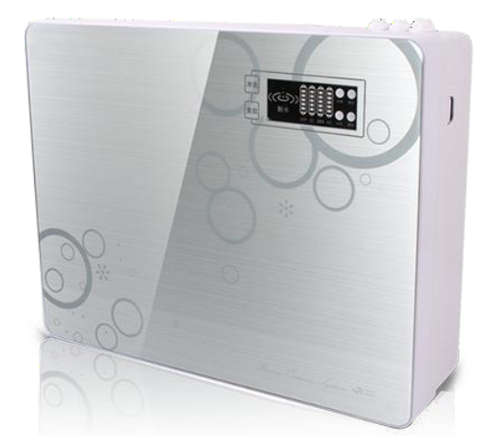
RO Water Purifier Series
RO纯水机系列
Item NO.: STW-ROD-2005 Clamp
G/W：13KG
Poroduct Size: 460*175*395MM
FIlter Flow：75GPD
Accessories list: Luxury three-fork big bend faucet 3.2g explosion-proof pressure barrel 75G self-priming pump 75GRO membrane true true solenoid valve true true high voltage switch 1.5A power supply.

Slide 20
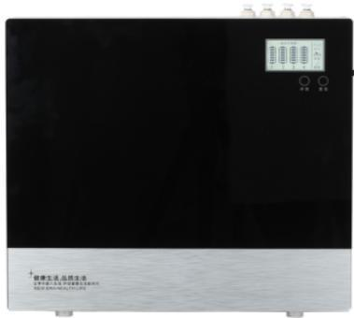
RO Water Purifier Series
RO纯水机系列
Item NO.: STW-ROD-2005 Clamp
G/W：13KG
Poroduct Size: 460*175*395MM
FIlter Flow：75GPD
Accessories list: Luxury three-fork big bend faucet 3.2g explosion-proof pressure barrel 75G self-priming pump 75GRO membrane true true solenoid valve true true high voltage switch 1.5A power supply.

Slide 21
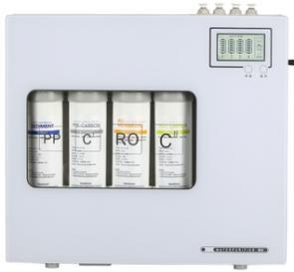
RO Water Purifier Series
RO纯水机系列
Item NO.: STW-ROD-2060
G/W：13KG
Poroduct Size: 460*175*395MM
FIlter Flow：75GPD
Accessories list: Luxury three-fork big bend faucet 3.2g explosion-proof pressure barrel 75G self-priming pump 75GRO membrane true true solenoid valve true true high voltage switch 1.5A power supply.

Slide 22
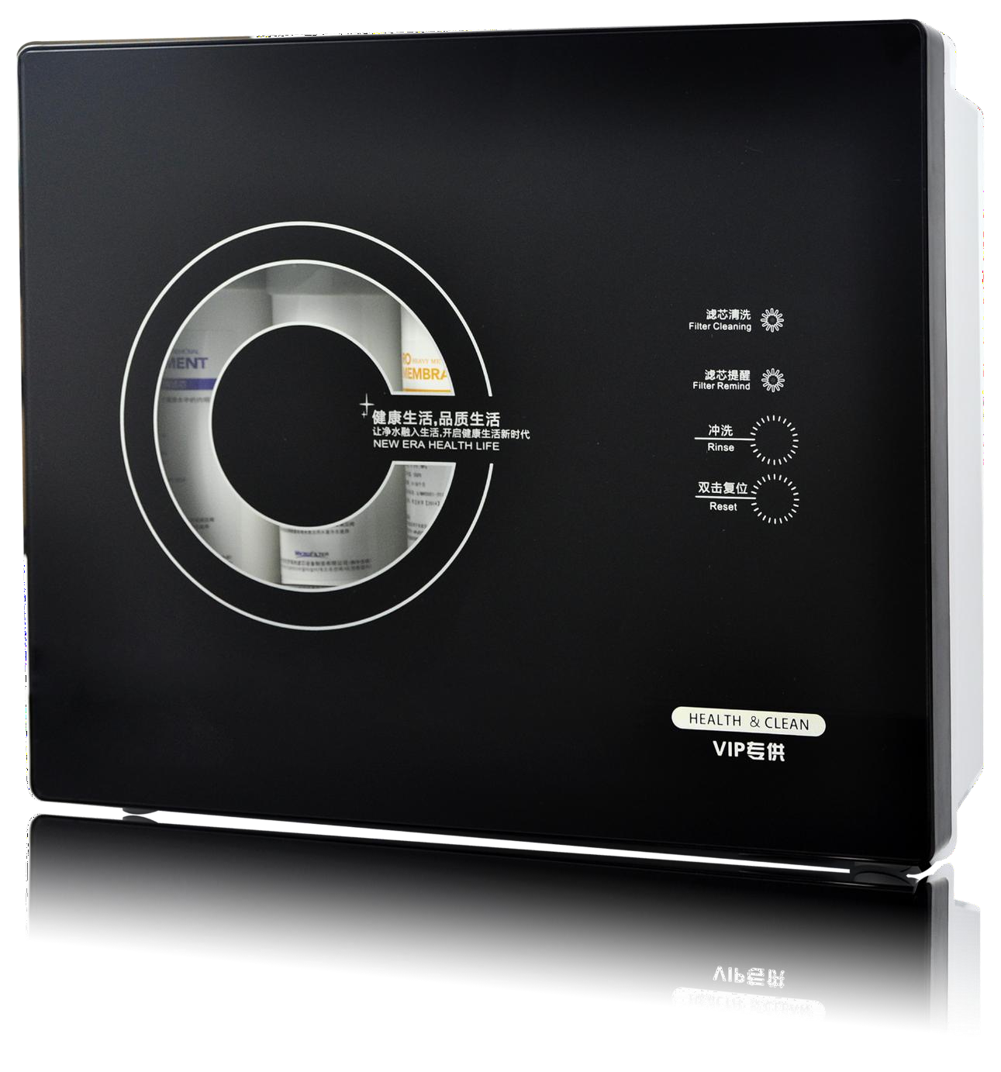
RO Water Purifier Series
RO纯水机系列
Item NO.: STW-ROD-2061
G/W：13KG
Poroduct Size: 460*175*395MM
FIlter Flow：75GPD
Accessories list: Luxury three-fork big bend faucet 3.2g explosion-proof pressure barrel 75G self-priming pump 75GRO membrane true true solenoid valve true true high voltage switch 1.5A power supply.

Slide 23
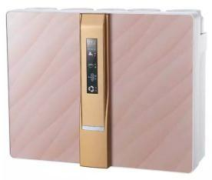
RO Water Purifier Series
RO纯水机系列
Item NO.: STW-ROD-2025
G/W：12KG
Poroduct Size: 510*160*385mm
FIlter Flow：75GPD
Accessories list: Luxury three-fork big bend faucet 3.2g explosion-proof pressure barrel 75G self-priming pump 75GRO membrane true true solenoid valve true true high voltage switch 1.5A power supply.

Slide 24
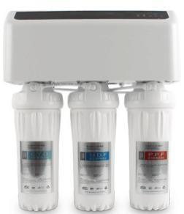
RO Water Purifier Series
O纯水机系列
Item NO.: STW-ROD-2080
G/W：12KG
Poroduct Size: 365*190*465mm
FIlter Flow：75GPD
Accessories list: Luxury three-fork big bend faucet 3.2g explosion-proof pressure barrel 75G self-priming pump 75GRO membrane true true solenoid valve true true high voltage switch 1.5A power supply.

Slide 25
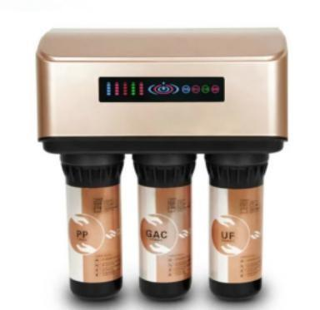
RO Water Purifier Series
RO纯水机系列
Item NO.: STW-ROD-A6
G/W：12KG
Poroduct Size: 370*200*465mm
FIlter Flow：75GPD
Accessories list: Luxury three-fork big bend faucet 3.2g explosion-proof pressure barrel 75G self-priming pump 75GRO membrane true true solenoid valve true true high voltage switch 1.5A power supply.

Slide 26
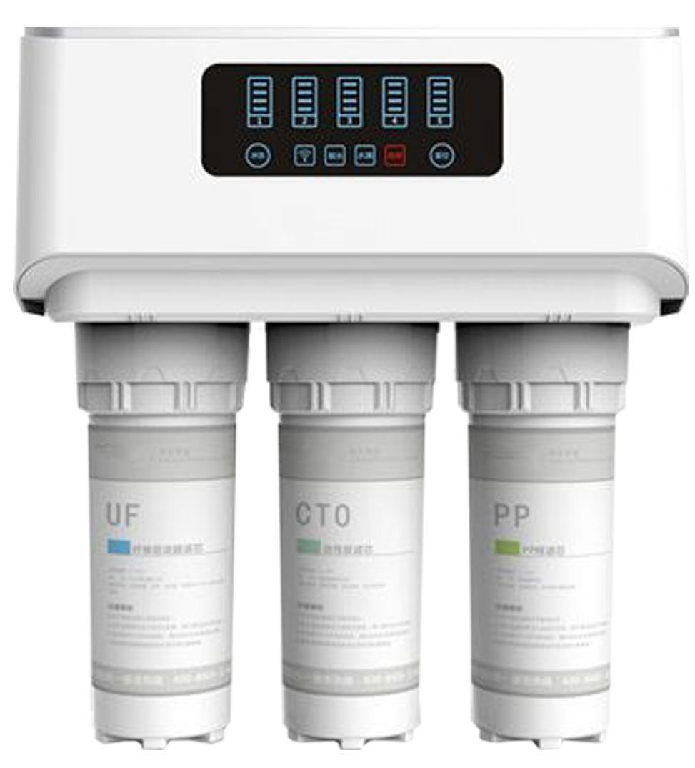
RO Water Purifier Series
RO纯水机系列
Item NO.: STW-ROD-A8
G/W：12KG
Poroduct Size: 450*270*465mm
FIlter Flow：75GPD
Accessories list: Luxury three-fork big bend faucet 3.2g explosion-proof pressure barrel 75G self-priming pump 75GRO membrane true true solenoid valve true true high voltage switch 1.5A power supply.

Slide 27
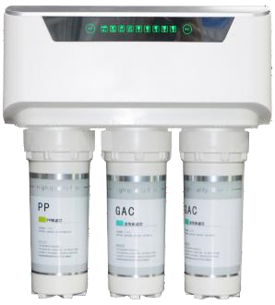
RO Water Purifier Series
RO纯水机系列
Item NO.: STW-ROD-WA8
G/W：12KG
Poroduct Size: 450*270*465mm
FIlter Flow：75GPD
Accessories list: Luxury three-fork big bend faucet 3.2g explosion-proof pressure barrel 75G self-priming pump 75GRO membrane true true solenoid valve true true high voltage switch 1.5A power supply.

Slide 28
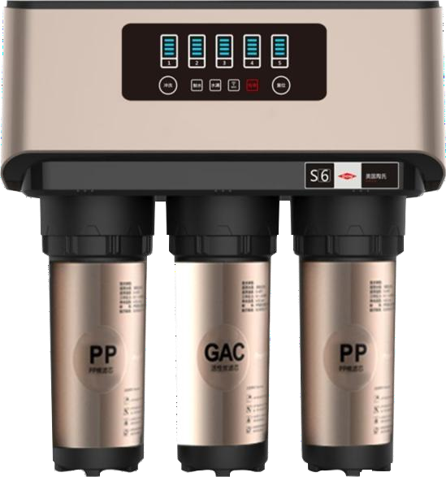
RO Water Purifier Series
Item NO.: STW-ROD-A8
G/W：12KG
Poroduct Size: 450*270*465mm
FIlter Flow：75GPD
Accessories list: Luxury three-fork big bend faucet 3.2g explosion-proof pressure barrel 75G self-priming pump 75GRO membrane true true solenoid valve true true high voltage switch 1.5A power supply.

Slide 29
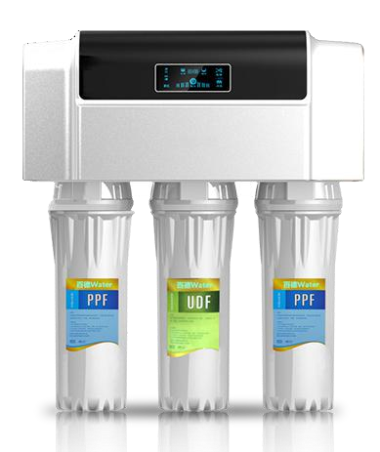
RO Water Purifier Series
RO纯水机系列
Item NO.: STW-ROD-112
G/W：12KG
Poroduct Size: 370*200*465mm
FIlter Flow：75GPD
Accessories list: Luxury three-fork big bend faucet 3.2g explosion-proof pressure barrel 75G self-priming pump 75GRO membrane true true solenoid valve true true high voltage switch 1.5A power supply.

Slide 30
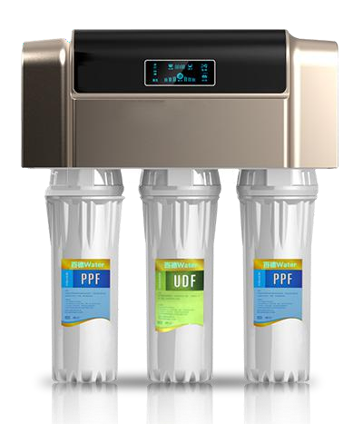
RO Water Purifier Series
RO纯水机系列
Item NO.: STW-ROD-112
G/W：12KG
Poroduct Size: 370*200*465mm
FIlter Flow：75GPD
Accessories list: Luxury three-fork big bend faucet 3.2g explosion-proof pressure barrel 75G self-priming pump 75GRO membrane true true solenoid valve true true high voltage switch 1.5A power supply.

Slide 31
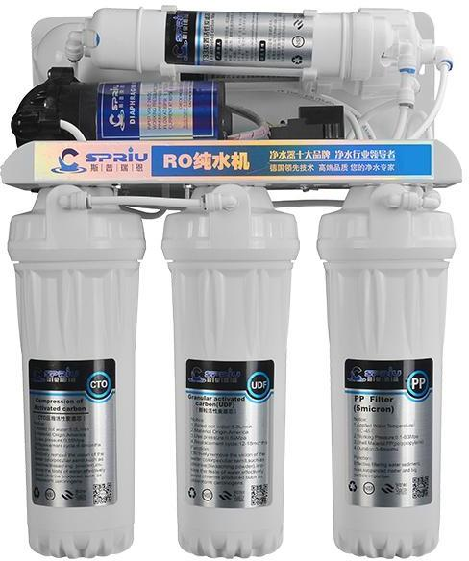
RO Water Purifier Series
RO纯水机系列
Item NO.: STW-ROD-007
G/W：12KG
Poroduct Size: 370*200*465mm
FIlter Flow：75GPD
Accessories list: Luxury three-fork big bend faucet 3.2g explosion-proof pressure barrel 75G self-priming pump 75GRO membrane true true solenoid valve true true high voltage switch 1.5A power supply.

Slide 32
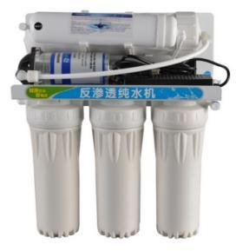
RO Water Purifier Series
RO纯水机系列
Item NO.: STW-ROD-108
G/W：11KG
Poroduct Size: 370*170*460mm
FIlter Flow：400GPD
Accessories list: luxury three-fork big bend faucet, 400G booster pump, 400GRO film, real solenoid valve real real flush valve real real high voltage switch 4A power supply

Slide 33
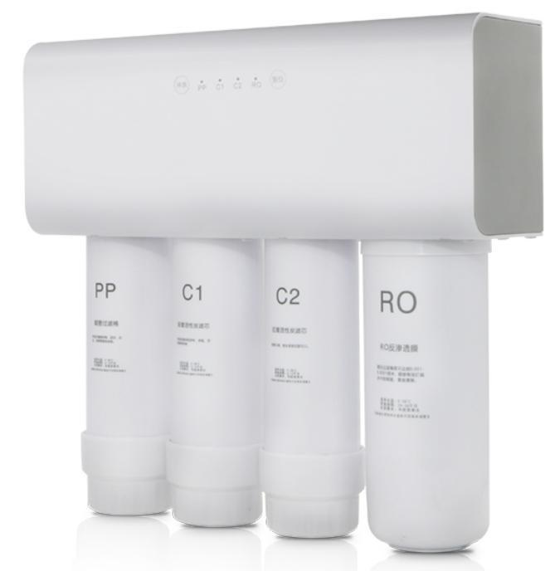
RO Water Purifier Series
RO纯水机系列
Item NO.: STW-ROD-3026
G/W：10KG
Poroduct Size: 433*160*423mm
FIlter Flow：500GPD
Accessories list: 304 brushed stainless steel faucet 500G no barrel 400G booster pump 500G clamp RO membrane 4A power supply kebo solenoid valve, Kebo 800CC combination valve, kebo high voltage switch Kebo check valve

Slide 34
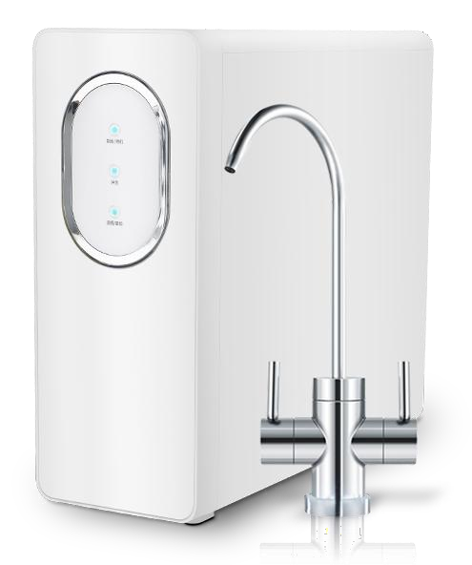
RO Water Purifier Series
RO纯水机系列
Item NO.: STW-ROD-3028
G/W：11KG
Poroduct Size: 450*270*465mm
FIlter Flow：500GPD
Accessories list: 400G delta water pump 500GG membrane, kebo solenoid valve national industry high and low voltage switch kebo wastewater automatic regulating valve 4A power supply American double water big bend faucet

Slide 35
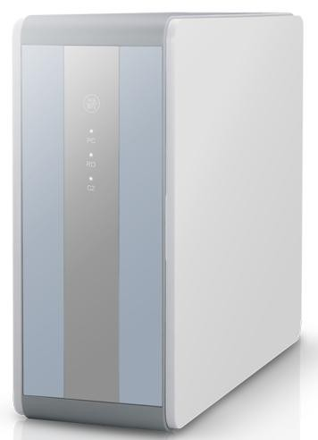
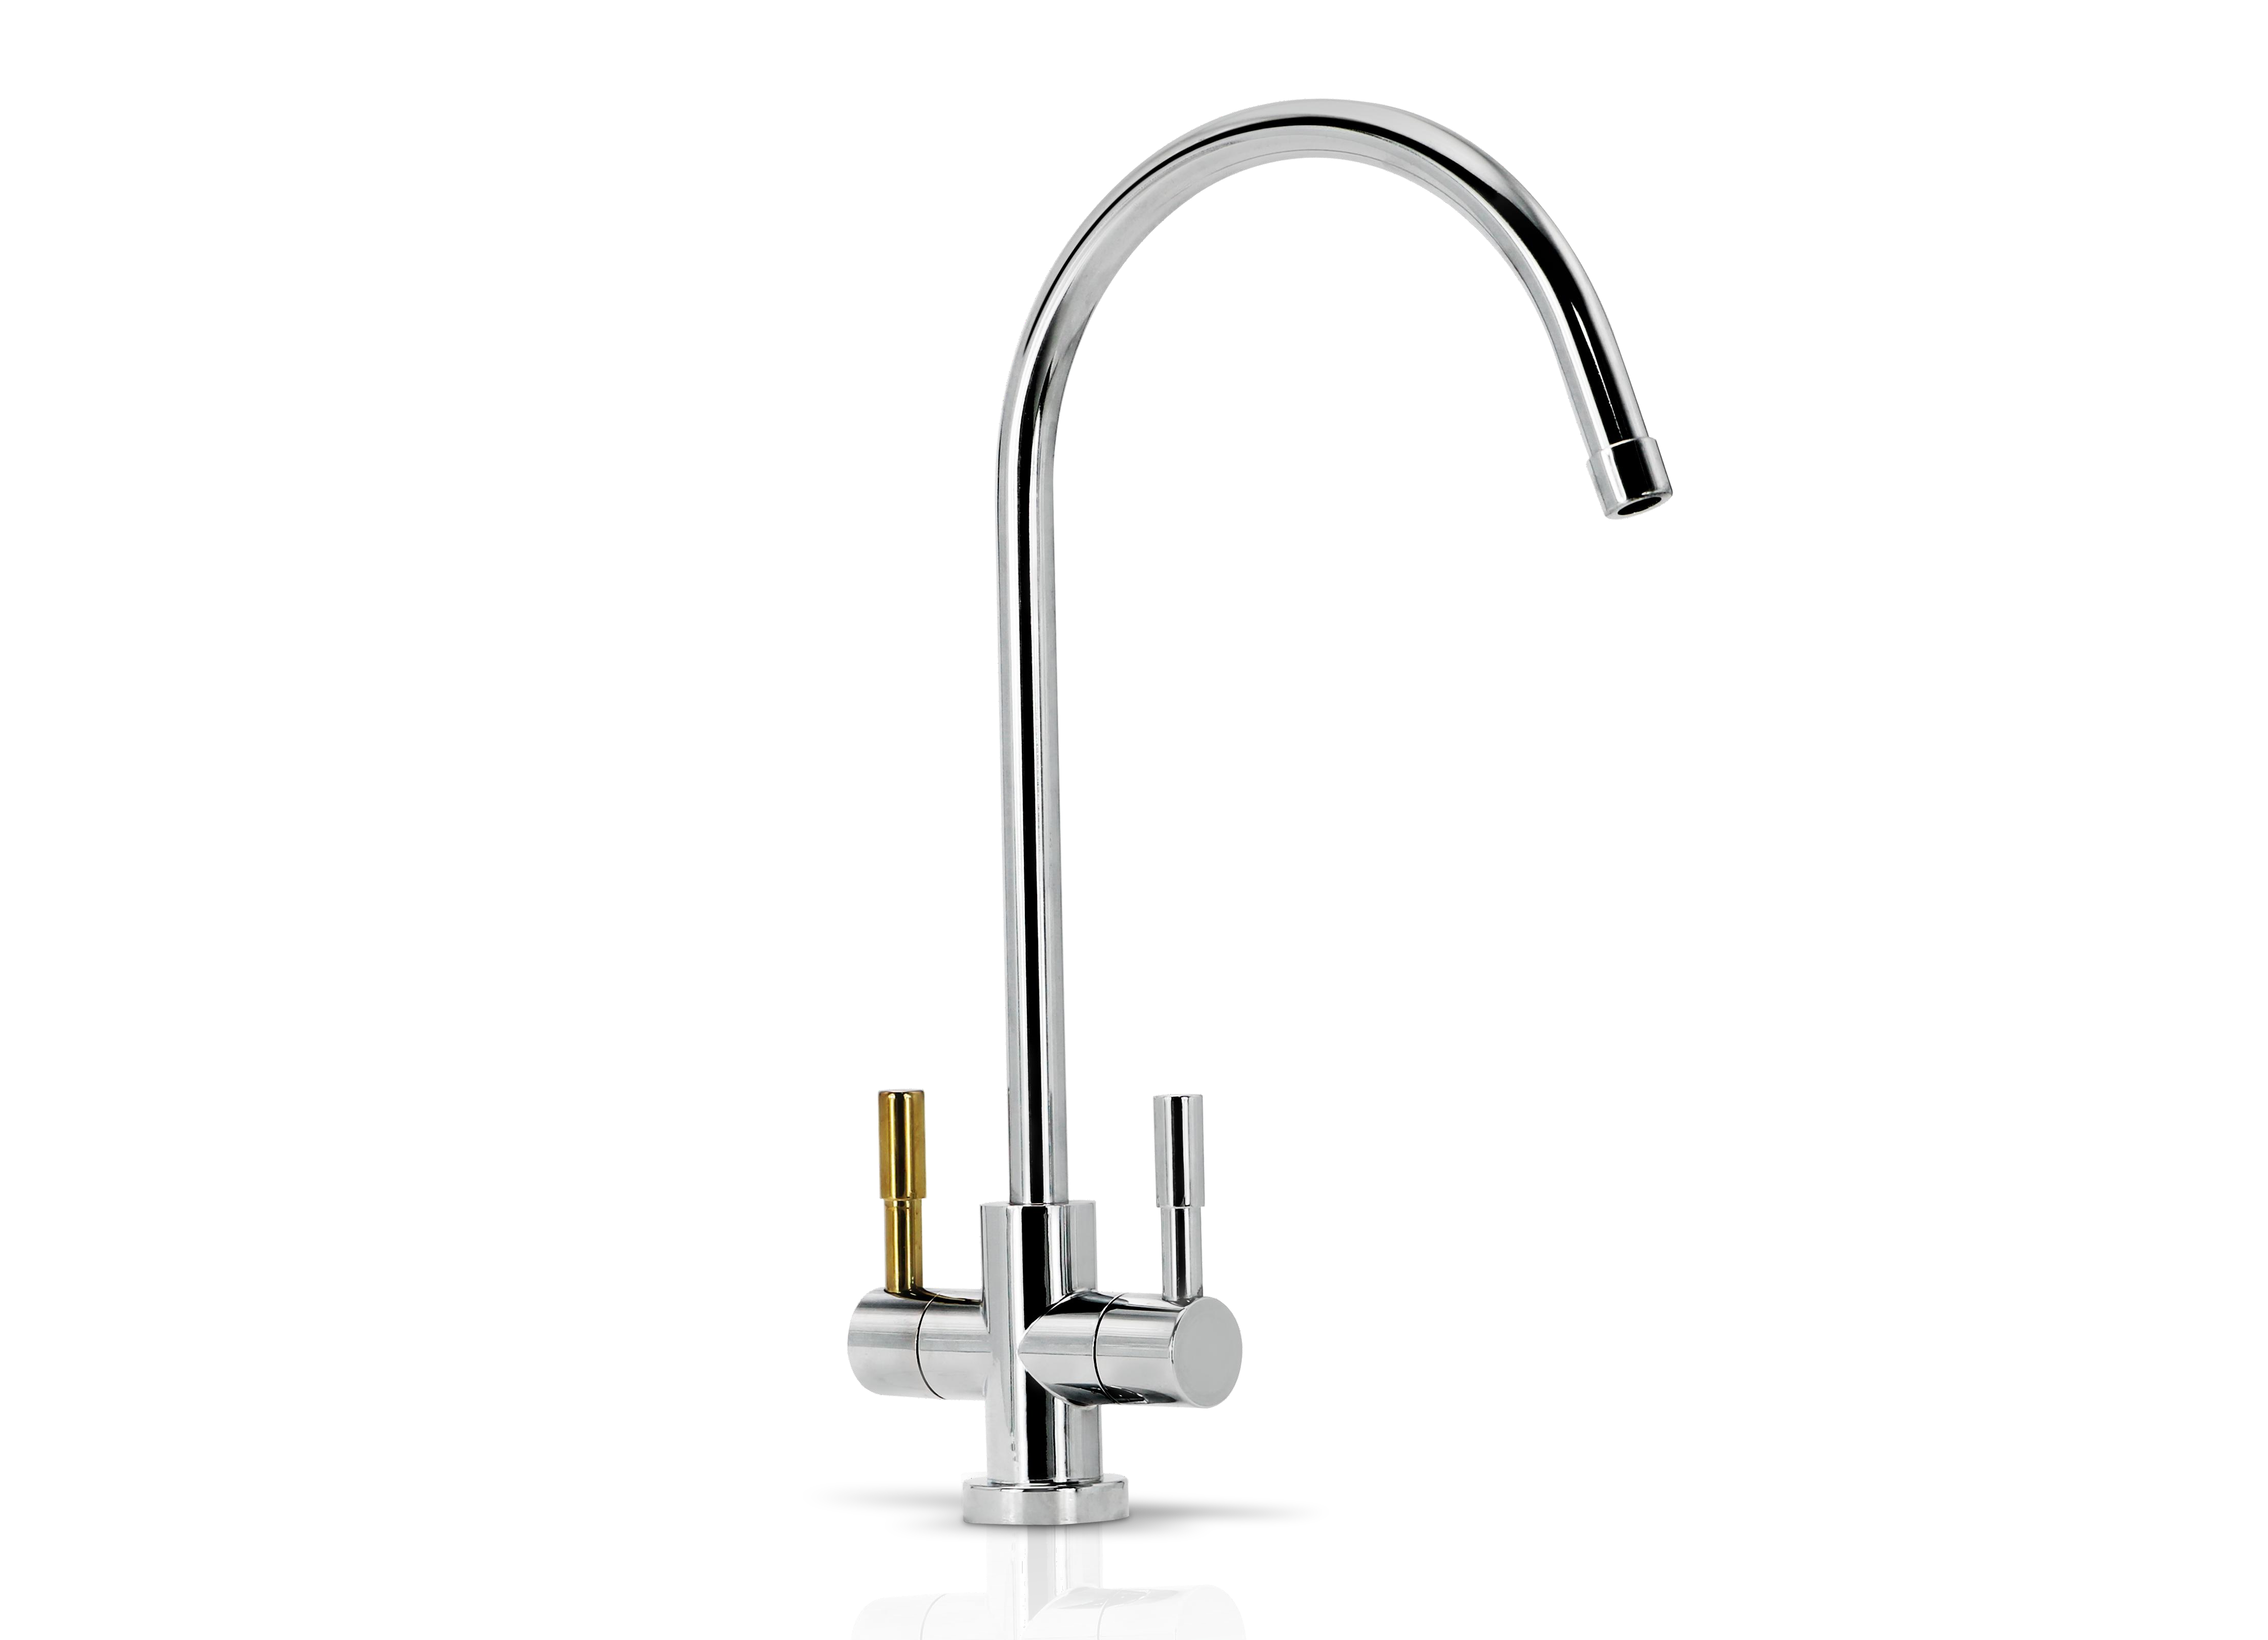
RO Water Purifier Series
Item NO.: STW-ROD-3031
G/W：12KG
Poroduct Size: 450*270*465mm
FIlter Flow：500GPD
Accessories list: 400G delta water pump 500GG membrane, kebo solenoid valve national industry high and low voltage switch kebo wastewater automatic regulating valve 4A power supply American double water big bend faucet
RO纯水机系列

Slide 36
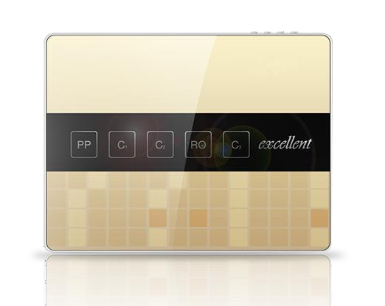
RO Water Purifier Series
RO纯水机系列
Item NO.: STW-ROD-2038
G/W：11KG
Poroduct Size: 470*120*355mm
FIlter Flow：125GPD
Accessories list: Luxury tri-fork faucet 3.2g explosion-proof pressure barrel 125G low pressure membrane imported PE pipe, nanyang four-side valve

Slide 37
RO Water Purifier Series
RO纯水机系列
Item NO.: STW-ROD-3010
G/W：11KG
Poroduct Size: 470*85*360mm
FIlter Flow：125GPD
Accessories list: Luxury tri-fork faucet 3.2g explosion-proof pressure barrel 125G low pressure membrane imported PE pipe, nanyang four-side valve

Slide 38
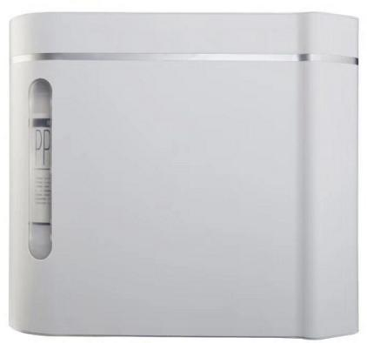
RO Water Purifier Series
UF超滤机系列
Item NO.: STW-ROD-01
G/W：5KG
Poroduct Size: 410*120*340mm
Filter Level：5 Level
Accessories list: three-fork faucet + faucet hanger +5m two-point PE pipe three-way + two-point ball valve

Slide 39
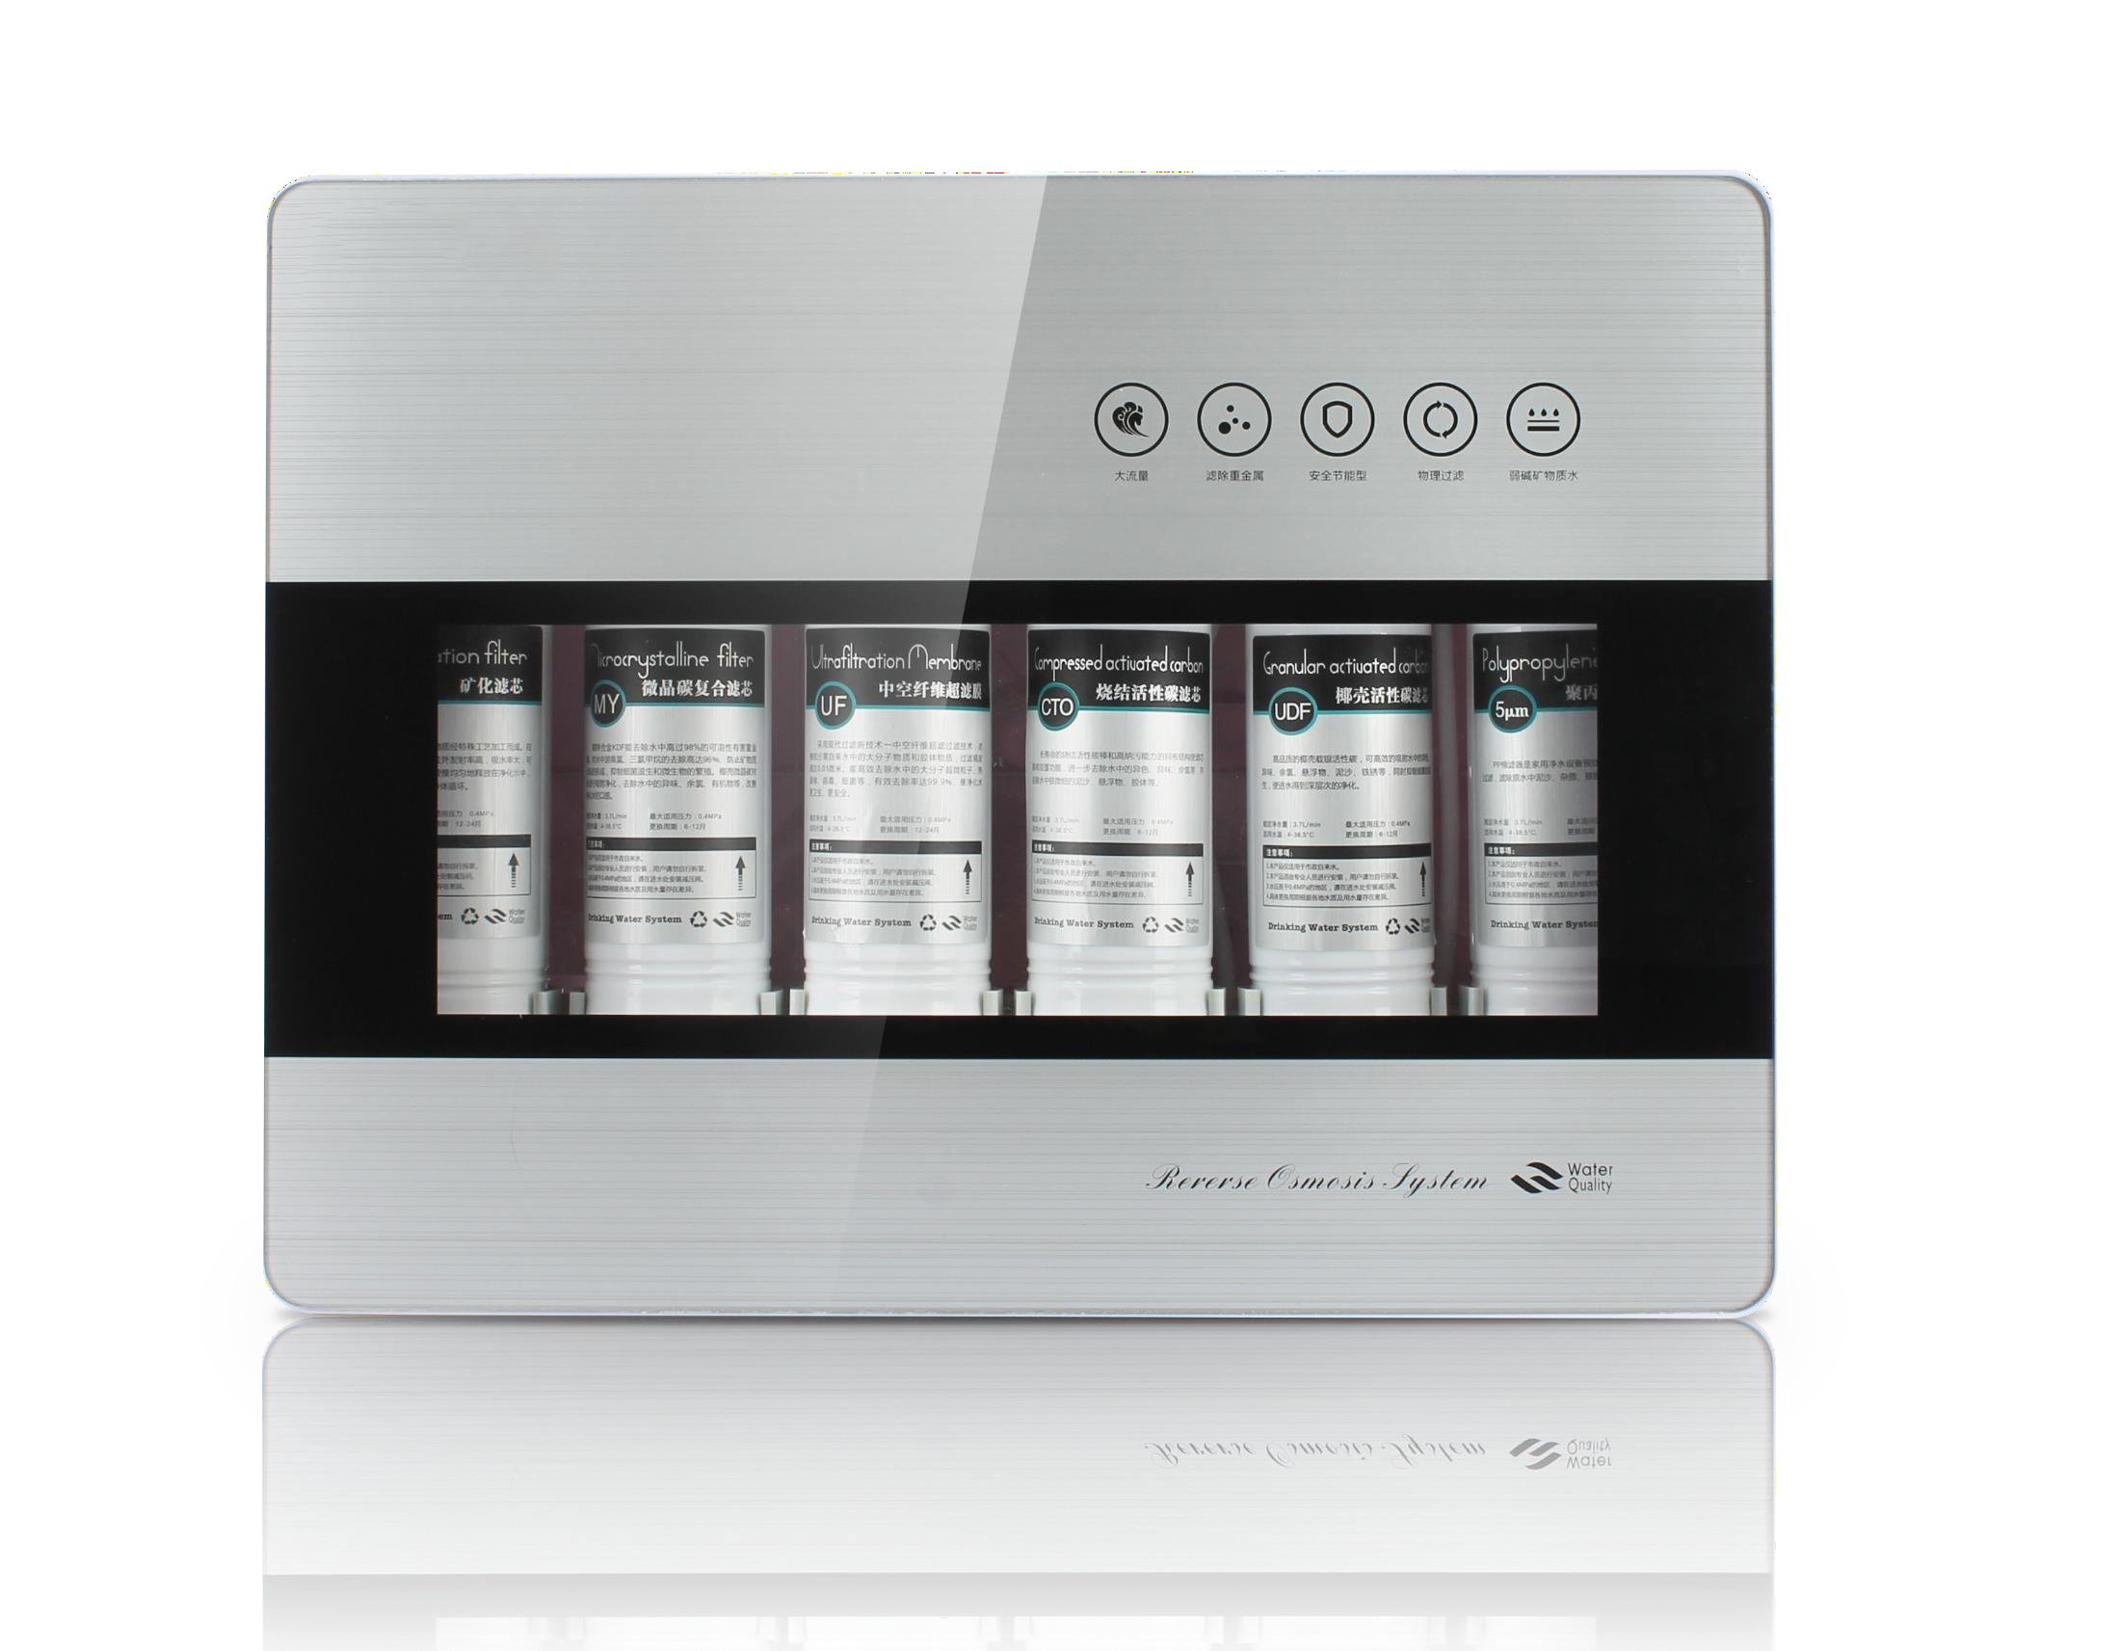
RO Water Purifier Series
UF超滤机系列
Item NO.: STW-ROD-2007
G/W：6KG
Poroduct Size: 470*120*355mm
Filter Level：5 Level
Accessories list: three-fork faucet + faucet hanger +5m two-point PE pipe three-way + two-point ball valve

Slide 40
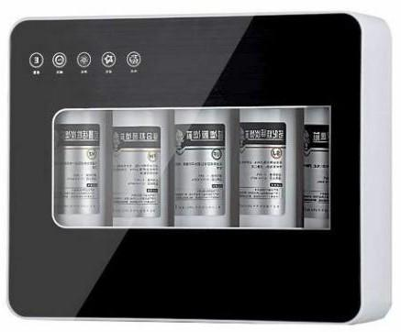
RO Water Purifier Series
UF超滤机系列
Item NO.: STW-ROD-1122
G/W：5KG
Poroduct Size: 415*120*355 mm
Filter Level：5 Level
Accessories list: three-fork faucet + faucet hanger +5m two-point PE pipe three-way + two-point ball valve

Slide 41
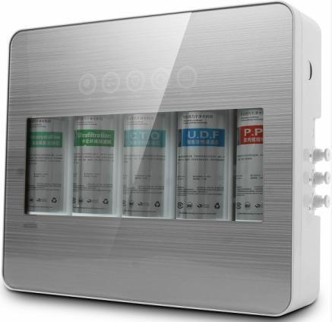
RO Water Purifier Series
UF超滤机系列
Item NO.: STW-ROD-1123
G/W：5KG
Poroduct Size: 415*120*355 mm
Filter Level：5 Level
Accessories list: three-fork faucet + faucet hanger +5m two-point PE pipe three-way + two-point ball valve

Slide 42
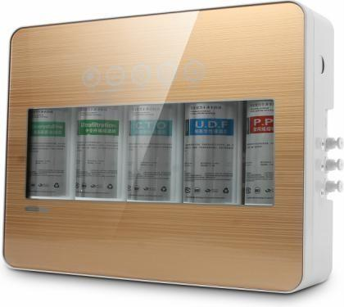
RO Water Purifier Series
UF超滤机系列
Item NO.: STW-ROD-2010
G/W：5KG
Poroduct Size: 415*120*355 mm
Filter Level：5 Level
Accessories list: three-fork faucet + faucet hanger +5m two-point PE pipe three-way + two-point ball valve

Slide 43
RO Water Purifier Series
UF超滤机系列
Item NO.: STW-ROD-2064
G/W：5KG
Poroduct Size: 415*120*355 mm
Filter Level：5 Level
Accessories list: three-fork faucet + faucet hanger +5m two-point PE pipe three-way + two-point ball valve

Slide 44
RO Water Purifier Series
UF超滤机系列
Item NO.: STW-ROD-2083
G/W：5KG
Poroduct Size: 170*170*335 mm
Filter Level：3 Level
Accessories list: three-fork faucet + faucet hanger +5m two-point PE pipe three-way + two-point ball valve
多色可选：

Slide 45
RO Water Purifier Series
UF超滤机系列
Item NO.: STW-ROD-28
G/W：5KG
Poroduct Size:320*100*420 mm
Filter Level：3+2 /3+3UF
Accessories list: three-fork faucet + faucet hanger +5m two-point PE pipe three-way + two-point ball valve

Slide 46
RO Water Purifier Series
UF超滤机系列
Item NO.: STW-ROD1073
G/W：5KG
Poroduct Size: 355*165*395mm
Filter Level：Level 5
Accessories list: three-fork faucet + faucet hanger +5m ,two-point PE pipe three-way + two-point ball valve

Slide 47
RO Water Purifier Series
UF超滤机系列
Item NO.: STW-ROD1064
G/W：6KG
Poroduct Size: 310*160*390mm
Filter Level：Level 5
Accessories list: three-fork faucet + faucet hanger +5m ,two-point PE pipe three-way + two-point ball valve

Slide 48
Central Water Purifier Series
UF超滤机系列
Item NO.: SWT-ROC-1000A
FLow Rate：1000L/H 1500L/H 2000L/H
Product Size: 89*460mm
Filter core specification: 75*410mm
Item NO.: STW-ROC-600A
FLow Rate：600L/H 1000L/H 1500L/H 2000L/H
Poroduct Size: 89*325mm
Filter core specification: 75*270mm

Slide 49
Central Water Purifier
UF超滤机系列
Item No.: STW-ROC-A18
Flow Rate：2000L/h
PrProduct Size: 102*815mm
Filter specifications: 90*760mm

Slide 50
Central Water Purifier
UF超滤机系列
Item No.: STW-ROC-A19
Flow Rate：2000L/h
PrProduct Size: 114*865mm
Filter specifications: 108*800mm
Item NO.: STW-ROC-A20
FLow Rate：2500L/h
Product Size: 114*1115mm
Filter specifications: 108*1050mm

Slide 51
Central Water Purifier
UF超滤机系列
Item No.: STW-ROC-A53
Flow Rate：2000L/h
Product Size: 127*570mm
Filter specifications: 110*470mm
Item No.: STW-ROC-A54
Flow Rate：3000L/h
Product Size: 127*740mm
Filter specifications: 110*640mm

Slide 52
Central Water Purifier
UF超滤机系列
Item No.: STW-ROC-A5 4000g
Flow Rate：5000L/h
Product Size: 127*1000mm
Filter specifications: 110*900mm
Item No.: STW-ROC-A6 5000g
Flow Rate：5000L/h
Product Size: 127*1085mm
Filter specifications: 110*985mm

Slide 53
Central Water Purifier
UF超滤机系列
Item No.: STW-ROC-A39 2000D
Flow Rate：2000L/h
Product Size: 168*370mm
Filter specifications: 160*300mm
Item No.: STW-ROC-A40 3000D
Flow Rate：3000L/h
Product Size: 168*460mm
Filter specifications: 160*390mm

Slide 54
Central Water Purifier
UF超滤机系列
Item No.: STW-ROC-A40 4000D
Flow Rate：4000L/h
Product Size: 168*570mm
Filter specifications: 160*500mm
Item No.: STW-ROC-A41 5000D
Flow Rate：5000L/h
Product Size: 168*680mm
Filter specifications: 160*610mm

Slide 55
Central Water Purifier
UF超滤机系列
Item No.: STW-ROC-A43 6000D
Flow Rate：6000L/h
Product Size: 168*790mm
Filter specifications: 160*720mm
Item No.: STW-ROC-A57 7000D
Flow Rate：7000L/h
Product Size: 168*910mm
Filter specifications: 160*820mm

Slide 56
Central Water Purifier
UF超滤机系列
Item No.: STW-ROC-A45 8000D
Flow Rate：8000L/h
Product Size: 168*1055mm
Filter specifications: 160*985mm
Item No.: STW-ROC-A46 10000D
Flow Rate：6000L/h
Product Size: 168*1270mm
Filter specifications: 1144*1200mm

Slide 57
Central Water Purifier
UF超滤机系列
Item No.: STW-ROC-A48 2000G Clamp
Flow Rate：2000L/h
Product Size: 127*570mm
Filter specifications: 110*470mm
Item No.: STW-ROC-A54 3000G Clamp
Flow Rate：3000L/h
Product Size: 127*740mm
Filter specifications: 110*640mm

Slide 58
Central Water Purifier
UF超滤机系列
Item No.: STW-ROC-A55 4000G Clamp
Flow Rate：4000L/h
Product Size: 127*1000mm
Filter specifications: 110*900mm
Item No.: STW-ROC-A56 5000G Clamp
Flow Rate：5000L/h
Product Size: 127*1085mm
Filter specifications: 110*985mm

Slide 59
Kitchen Central Water Purifier
UF超滤机系列
Item No.: STW-ROC-C800 800G
Flow Rate：800L/h
Product Size: 102*420mm
Filter specifications: 85*390mm

Slide 60
Kitchen Central Water Purifier
UF超滤机系列
Item No.: STW-ROC-C071 600G
Flow Rate：600L/h 1500L/h,2500L/h
Product Size: 114*370mm
Filter specifications: 90*310mm
Item No.: STW-ROC-C062 1000G
Flow Rate：1000L/h 2000L/h,3000L/h
Product Size: 114*430mm
Filter specifications: 90*370mm

Slide 61
Kitchen Central Water Purifier
UF超滤机系列
Item No.: STW-ROC-C071W 600G
Flow Rate：600L/h 1500L/h,2500L/h
Product Size: 114*370mm
Filter specifications: 90*310mm
Item No.: STW-ROC-C062W 600G
Flow Rate：1000L/h 2000L/h,3000L/h
Product Size: 114*430mm
Filter specifications: 90*330mm

Slide 62
Kitchen Central Water Purifier
UF超滤机系列
Item No.: STW-ROC-C33G 1000E
Flow Rate：1000L/h
Product Size: 180*660mm
Filter specifications: 90*420mm

Slide 63
Kitchen Central Water Purifier
UF超滤机系列
Item No.: STW-ROC-A77 1000L
Flow Rate：1000L/h
Product Size: 150*350mm
Filter specifications: 95*300mm
Item No.: STW-ROC-A73 2000L
Flow Rate：2000L/h
Product Size: 150*440mm
Filter specifications: 95*500mm

Slide 64
Kitchen Central Water Purifier
Item No.: STW-ROC-A735 3500L
Flow Rate：3500L/h
Product Size: 230*420mm
Filter specifications: 160*350mm
Item No.: STW-ROC-A776 6000L
Flow Rate：6000L/h
Product Size: 230*500mm
Filter specifications: 160*450mm

Slide 65
Kitchen Central Water Purifier
UF超滤机系列
Item No.: STW-ROC-C10T 10000L
Flow Rate：10000L/h
Product Size: 230*900mm
Filter specifications: 160*850mm

Slide 66
Kitchen Central Water Purifier
UF超滤机系列
Item No.: STW-ROC-C800L2 800L
Flow Rate：800L/h
Product Size: 470*165*200mm
Filter specifications: 85*360mm
Item No.: STW-ROC-C1000Z 1000L
Flow Rate：1000L/h
Product Size: 220*480mm
Filter specifications: 90*420mm

Slide 67
Kitchen Central Water Purifier
UF超滤机系列
Item No.: STW-ROC-A69 1000L
Flow Rate：1000L/h
Product Size: 220*500mm
Filter specifications: 90*370mm
Item No.: STW-ROC-CA35 1000L
Flow Rate：1000L/h
Product Size: 220*540mm
Filter specifications: 90*420mm

Slide 68
Kitchen Central Water Purifier
UF超滤机系列
Item No.: STW-ROC-A70F1 1000L
Flow Rate：1000L/h
Product Size: 89*362mm
Filter specifications: 75*410mm
Item No.: STW-ROC-A70F 1000L
Flow Rate：1000L/h
Product Size: 102*370mm
Filter specifications: 90*420mm

Slide 69
Kitchen Central Water Purifier
UF超滤机系列
Item No.: STW-ROC-A70F 1000L
Flow Rate：1000L/h
Product Size: 265*480mm
Filter specifications: 75*410mm
Item No.: STW-ROC-A70F2 1000L
Flow Rate：1000L/h
Product Size: 285*490mm
Filter specifications: 90*420mm

Slide 70
Kitchen Central Water Purifier
UF超滤机系列
Item No.: STW-ROC-C02 1000P
Flow Rate：1000L/h
Product Size: 480*140*280mm
Filter specifications: 90*420mm
Item No.: STW-ROC-Z02 1000P
Flow Rate：1000L/h
Product Size: 480*140*280mm
Filter specifications: 90*420mm

Slide 71
Ro Water Purifier
UF滤机系列
Item No.: STW-ROD-A300L (3+0)
Flow Rate：300L/h
Product Size: 355*155*380mm
Filter specifications: 10inch

Slide 72
Ro Water Purifier
UF超滤机系列
Item No.: STW-ROD-A045 (3+1)
Flow Rate：300L/h
Product Size: 355*155*410mm
Filter specifications: 10inch

Slide 73
Ro Water Purifier
UF超滤机系列
Item No.: STW-ROD-A08 (3+2)
Flow Rate：300L/h
Product Size: 355*155*450mm
Filter specifications: 10inch

Slide 74
Ro Water Purifier
Item No.: STW-ROD-A081 (4+1)
Flow Rate：300L/h
Product Size: 530*120*390mm
Filter specifications: 10inch

Slide 75
Ro Water Purifier
UF超滤机系列
Item No.: STW-ROD-A082 (4+1)
Flow Rate：300L/h
Product Size: 530*120*440mm
Filter specifications: 10inch

Slide 76
Ro Water Purifier
UF超滤机系列
Item No.: STW-ROD-A083 (4+2)
Flow Rate：300L/h
Product Size: 530*120*450mm
Filter specifications: 10inch

Slide 77
Wholehouse Central Water Purifier
UF超滤机系列
Item No.: STW-ROD-C046 4000F
Flow Rate：4000L/h
Product Size: 583*325*338mm
Filter specifications: 170*395mm
Item No.: STW-ROD-C046 5000F
Flow Rate：5000L/h
Product Size: 683*325*338mm
Filter specifications: 170*495mm

Slide 78
Wholehouse Central Water Purifier
Item No.: STW-ROD-C095 6000F
Flow Rate：6000L/h
Product Size: 783*325*338mm
Filter specifications: 170*595mm
Item No.: STW-ROD-C046 4000F
Flow Rate：4000L/h
Product Size: 583*325*338mm
Filter specifications: 170*395mm

Slide 79
Wholehouse Central Water Purifier
UF超滤机系列
Item No.: STW-ROD-C065 5000F
Flow Rate：5000L/h
Product Size: 683*325*338mm
Filter specifications: 170*495mm
Item No.: STW-ROD-C095 6000F
Flow Rate：6000L/h
Product Size: 783*325*338mm
Filter specifications: 170*595mm

Slide 80
Wholehouse Central Water Purifier
Item No.: STW-ROD-C6000E
Flow Rate：6000L/h
Product Size: 710*300*255mm
Filter specifications: 170*595mm

Slide 81
SS Ultra-filter Faucet Water Purifier
Item No.: STW-ROF-A97
Flow Rate：500L/h
Product Size: 130*310mm
Filter specifications: 10inch
Item No.: STW-ROF-A97B
Flow Rate：500L/h
Product Size: 130*310mm
Filter specifications: 10inch

Slide 82
SS Ultra-filter Faucet Water Purifier
Item No.: STW-ROF-TC1
Flow Rate：500L/h
Product Size: 315*420mm
Filter specifications: 10inch
Item No.: STW-ROF-A1000P
Flow Rate：1000L/h
Product Size: 133*280mm
Filter specifications: 133*200mm

Slide 83
SS Ultra-filter Faucet Water Purifier
UF超滤机系列
Item No.: STW-ROF-A006
Flow Rate：600L/h
Product Size: 135*135*460mm
Filter specifications: 75*280m
Item No.: STW-ROF-T800
Flow Rate：600L/h
Product Size: 135*135*460mm
Filter specifications: 85*225m

Slide 84
SS Ultra-filter Faucet Water Purifier
Item No.: STW-ROF-A1
Flow Rate：300L/h
Product Size: 100*310mm
Filter specifications: 10inch
Item No.: STW-ROF-A4
Flow Rate：300L/h
Product Size: 100*310mm
Filter specifications: 10inch

Slide 85
Ultra-filter Faucet Water Purifier
UF超滤机系列
Item No.: STW-ROF-T7
Flow Rate：120L/h
Product Size: 100*310mm
Filter Material: Diatom ceramic

Slide 86
Commercial Pure Water Machine
商用纯水机系列
Item No.: STW-ROC-D002 200G
Gross Weigh: 16KG
Filter Level：5 Stages
Product Size: 400*250*770 mm
Flow Speed: 200GPM

Slide 87
Commercial Pure Water Machine
商用纯水机系列
Item No.: STW-ROC-D007 100G
Gross Weigh: 40KG
Filter Level：5 Stages
Product Size: 550*370*970 mm
Flow Speed: 100GPM

Slide 88
Commercial Pure Water Machine
商用纯水机系列
Item No.: STW-ROC-D007Y 100G
Gross Weigh: 40KG
Filter Level：5 Stages
Product Size: 550*370*970 mm
Flow Speed: 100GPM

Slide 89
Commercial Pure Water Machine
商用纯水机系列
Item No.: STW-ROC-D007S 200G
Gross Weigh: 40KG
Filter Level：5 Stages
Product Size: 550*370*970 mm
Flow Speed: 200GPM

Slide 90
Commercial Pure Water Machine
商用纯水机系列
Item No.: STW-ROC-S10 100G
Gross Weigh: 40KG
Filter Level：5 Stages
Product Size: 620*400*1250 mm
Flow Speed: 100GPM

Slide 91
Commercial Pure Water Machine
商用纯水机系列
Item No.: STW-ROC-W10 100G
Gross Weigh: 40KG
Filter Level：5 Stages
Product Size: 550*370*1200 mm
Flow Speed: 100GPM

Slide 92
Home Use Water Softener
商用纯水机系列
Item No.: STW-RSF-1200L 1200A
Usage: 1-3 Persons
Resin：11L
Product Size: 525*325*615mm
Flow Speed: 1200LPH

Slide 93
Home Use Water Softener
商用纯水机系列
Item No.: STW-RSF-2000L
Usage: 4-7 Persons
Resin：25L
Product Size: 525*326*1070 mm
Flow Speed: 2000LPH

Slide 94
Home Use Water Softener
商用纯水机系列
Item No.: STW-RSF-2500L
Usage: 5-8 Persons
Resin：28L
Product Size: 480*312*1070 mm
Flow Speed: 2000LPH

Slide 95
Home Use Water Softener
商用纯水机系列
Item No.: STW-RSF-S1200L
Usage: 1-2 Persons
Resin：4KG
Product Size: 200*350 mm
Flow Speed: 1200LPH

Slide 96
Wall Hang Pipeline Water Purifier
商用纯水机系列
Item No.: STW-ROD-J086
Power: Hot 2200W/Cold 70W
Heat Power：550W
Product Size: 300*430*85 mm
Flow Speed: 5L/h(≥90℃)

Slide 97
Wall Hang Pipeline Water Purifier
商用纯水机系列
Item No.: STW-ROD-J087
Power: Hot 2200W/Cold 70W
Heat Power：550W
Product Size: 300*430*85 mm
Flow Speed: 5L/h(≥90℃)

Slide 98
Wall Hang Pipeline Water Purifier
商用纯水机系列
Item No.: STW-ROD-J088
Power: Hot 2200W/Cold 70W
Heat Power：550W
Product Size: 300*430*85 mm
Flow Speed: 5L/h(≥90℃)

Slide 99
Wall Hang Pipeline Water Purifier
商用纯水机系列
Item No.: STW-ROD-J088
Power: Hot 2200W/Cold 70W
Heat Power：550W
Product Size: 300*430*85 mm
Flow Speed: 5L/h(≥90℃)

Slide 100
Wall Hang Pipeline Water Purifier
商用纯水机系列
Item No.: STW-ROD-H086
Power: Hot 2200W/Cold 70W
Heat Power：550W
Product Size: 300*430*85 mm
Flow Speed: 5L/h(≥90℃)

Slide 101
Wall Hang Pipeline Water Purifier
商用纯水机系列
Item No.: STW-ROD-H087
Power: Hot 2200W/Cold 70W
Heat Power：550W
Product Size: 300*430*85 mm
Flow Speed: 5L/h(≥90℃)

Slide 102
Wall Hang Pipeline Water Purifier
商用纯水机系列
Item No.: STW-ROD-H088
Power: Hot 2200W/Cold 70W
Heat Power：550W
Product Size: 300*430*85 mm
Flow Speed: 5L/h(≥90℃)

Slide 103
Wall Hang Pipeline Water Purifier
商用纯水机系列
Item No.: STW-ROD-H089
Power: Hot 2200W/Cold 70W
Heat Power：550W
Product Size: 300*430*85 mm
Flow Speed: 5L/h(≥90℃)

Slide 104
Wall Hang Pipeline Water Purifier
商用纯水机系列
Item No.: STW-ROD-H092(TDS display)
Rated voltage: 220V/50HZ
Rated power: hot 2200W
Heating capacity: 30L/h
Product size: 330*430*90mm

Slide 105
Wall Hang Pipeline Water Purifier
商用纯水机系列
Item No.: STW-ROD-H094(TDS display)
Rated voltage: 220V/50HZ
Rated power: hot 2200W
Heating capacity: 30L/h
Product size: 330*430*90mm

Slide 106
Wall Hang Pipeline Water Purifier
商用纯水机系列
Item No.: STW-ROD-H093(TDS display)
Rated voltage: 220V/50HZ
Rated power: hot 2200W
Heating capacity: 30L/h
Product size: 330*430*90mm

Slide 107
Vertical pipeline RO integrated machine
商用纯水机系列
Item No.: STW-RBD-H082
Rated voltage: 220V/50HZ
Hot water capacity: ≧12L/ h (≧98℃)
Heating capacity: ≧1.1L/min
Product size: 410*430*1520mm
Water taking type: touch the button water, child lock function, big hot bladder, intelligent display

Slide 108
Vertical pipeline RO integrated machine
商用纯水机系列
Item No.: STW-RBD-H078
Rated voltage: 220V/50HZ
Hot water capacity: ≧12L/ h (≧98℃)
Heating capacity: ≧1.1L/min
Product size: 360*400*1250mm
Water taking type: touch the button water, child lock function, big hot bladder, intelligent display

Slide 109
Vertical pipeline RO integrated machine
商用纯水机系列
Item No.: STW-RBD-H088
Rated voltage: 220V/50HZ
Hot water capacity: ≧12L/ h (≧98℃)
Heating capacity: ≧1.1L/min
Product size: 320*390*1380mm
Water taking type: touch the button water

Slide 110
Vertical pipeline RO integrated machine
Item No.: STW-RBD-H088
Rated Power: 2000W
Hot water capacity: ≧12L/ h (≧98℃)
Product size: 420*385*1200mm
Water taking type: touch the button water

Slide 111
Vertical pipeline RO integrated machine
Item No.: STW-RBD-H098
Rated Power: 2000W
Hot water capacity: ≧24L/ h (≧98℃)
Product size: 310*300*1030mm

Slide 112
Vertical pipeline RO integrated machine
Item No.: STW-RBD-H099
Rated Power: 2000W
Hot water capacity: ≧24L/ h (≧98℃)
Product size: 310*300*1030mm

Slide 113
Vertical pipeline RO integrated machine
Item No.: STW-RBD-H001
Rated Power: 550W
Hot water capacity: ≧5L/ h (≧90℃)
Product size: 345*325*1250mm

Slide 114
Vertical pipeline RO integrated machine
Item No.: STW-RBD-H001
Rated Power: 550W
Hot water capacity: ≧1.7L/ h (≧90℃)
Product size: 345*325*1100mm

Slide 115
Vertical pipeline RO integrated machine
Item No.: STW-RBD-H017
Rated Power: 550W
Hot water capacity: ≧1.7L/ h (≧90℃)
Product size: 345*325*1100mm

Slide 116
Vertical pipeline RO integrated machine
Item No.: STW-RBD-H09
Rated Power: 550W
Hot water capacity: ≧1.7L/ h (≧90℃)
Product size: 345*325*1100mm

Slide 117
Vertical pipeline RO integrated machine
Item No.: STW-RBD-T09
Rated Power: 550W
Hot water capacity: ≧1.7L/ h (≧90℃)
Product size: 345*325*1100mm

